Slide 1
Probability, Distributions & Statistical Tests using Python
Notes:
Notes:
Do: <Explain what the facilitator needs to do.>.
Tell: <Summarize what the facilitator needs to say.>
Ask: <List the question/s the facilitator should ask the participants.>
Expected Responses: <List the responses facilitator might get from the participants on the asked question/s.>
Show: <List what the facilitator needs to show.>

Slide 2
CONTENTS
Over view to Probability
Random variable and probability Distributions
Hypothesis Testing
P value & significance level
Z test
t-Test
Chi-square test
Goodness of fit test

Slide 3
Overview to Probability
Certain
Probability is the likelihood that the event will occur
Zero probability implies that something is impossible and A probability of 1 means something is certain
First, Second and Third ways of Probability are
First- Compute using classical probability definition; Example -rolling dice
Second: Compute using empirical data; Example-Rain Next day based on history
Third: Subjective Method- Compute based on judgment; Example: Sales forecast
Impossible

Slide 4

Probability terminology
Random Experiment- Outcome is not known with certainty
Sample space : Set of all possible outcome of an experiment;
Eg: Tossing of two coins
Eg: Television rating for a program s={x|X€R, 0≤X ≤100}
Event: Subset of a sample space
Eg: Life of a capital equipment being less than one year

Slide 5
Random Variables
It is a function that maps every outcome in the sample space to a real number
Random variable can be classified in to discrete and continuous depends on the value it can take
Discrete Random variable
RV X can assume only a finite or countably infinite set of values
Customer churn : X can take binary values churn and no churn
Credit rating (Category ): X can be Low, medium and High
No of orders received at a e-commerce retailer which can be countably infinite
Continuous Random variable
RV X can take value from an infinite set of values
Time to failure of an engineering system
% of attrition of employees of an organization

Slide 6
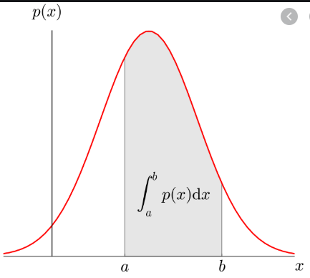
PMF , CDF & PDF
For Discrete RV
Discrete RV are described through probability mass function (PMF) and cumulative distribution function(CDF)
P(X=10) PMF Point function
P(X≤10) CDF Cumulative Function
For Continuous RV
Described through Probability distribution function (PDF) and cumulative distribution function(CDF)

Slide 7
Binomial Distribution
Fixed number n independent observations
Each observation falls into one of just two categories
may be labeled “success” and “failure”
The probability of success, p, is the same for each observation
If X has the binomial distribution with n observations and probability p of success on each observation, the possible values of X are 0, 1, 2, …, n. If k is any one of these values, then
If X has the binomial distribution with n observations and probability p of success on each observation, then the mean and standard deviation of X are

Slide 8
Example of Binomial Distribution
Statement:
Fashion Trend outline (FTO) is an ecommerce company that sells women apparel. It is observed that 10 % of their customers return the item purchased by them for many reasons (Size, color and material mismatch) . On a specific day, 20 customers purchased item from FTO. Calculate
Probability that exactly 5 customers will return the items
Probability that a maximum of 5 customers will return the items
Probability that more than 5 customers will return the purchased items by them
Average number of customers who are likely to return the items and the variance and standard deviation of the number of returns.
Solution : Probability and Distributions.ipynb

Slide 9
Poison Distribution
Poisson distribution is for counts—if events happen at a constant rate over time, the Poisson distribution gives the probability of X number of events occurring in time T or Space
Eg: Number of cash withdrawals at an ATM, No of Potholes on Bangalore road
If X has the poison distribution with λ is the rate of occurrence of the event, then the probability that X=k (a particular count) is
Poison mean:
Variance:

Slide 10
Example of Poison Distribution
Statement:
The number of calls arriving at a call center follows a poison distribution at 10 calls per hour. Calculate
The probability that the number of calls with maximum 5
The probability that the number of calls over 3-hour period will exceed 30.
Solution : Probability and Distributions.ipynb

Slide 11
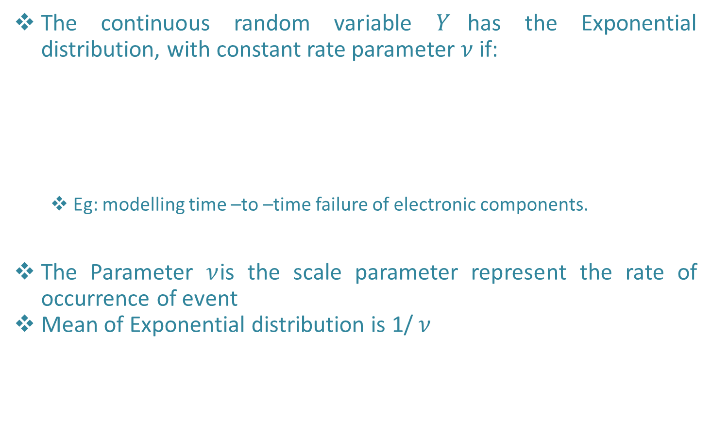
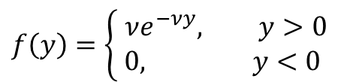
Exponential Distribution
The continuous random variable $Y$has the Exponential distribution, with constant rate parameter $ν$ if:
Eg: modelling time –to –time failure of electronic components.
The Parameter $ν$is the scale parameter represent the rate of occurrence of event
Mean of Exponential distribution is 1/ $ν$
$$f\left(y\right)=\left\{\begin{aligned} νe^{−νy}, y>0 \\ 0, & y<0\end{aligned}\right.$$

Slide 12
Example of Exponetail Distribution
Statement:
The time to time failure of an avionic system follows and exponential distribution with mean time between failures (MTBF) of 100 hours. Calculate
The probability that the system fail before 1000 hours
The probability that it will not fail up to 2000 hours
The time by which 10% of the system will fail (i.e Calculate P10 life)
Note: MTBF is 1000 hours , so mean is inverse of this.
Solution : Probability and Distributions.ipynb

Slide 13
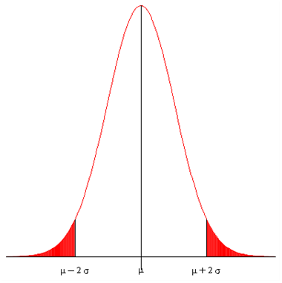





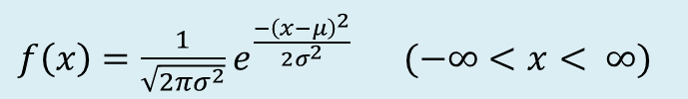
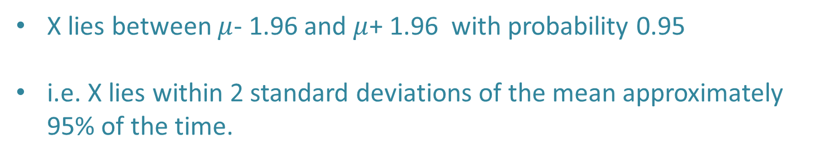
Normal Distribution
The continuous random variable $X$has the Normal distribution(Gaussian distribution) if the pdf is:
$f\left(x\right)=\frac{1}{\sqrt{2πσ^{2}}}e^{\frac{{−\left(x−μ\right)}^{2}}{2σ^{2}}} (−∞<x< ∞)$
X lies between $μ$- 1.96 and $μ$+ 1.96 with probability 0.95
i.e. X lies within 2 standard deviations of the mean approximately 95% of the time.
$μ:$ mean
$$\int_{−∞}^{∞}{f\left(x\right)dx=1}$$
$$σ$$
$σ:$ standard deviation

Slide 14
Example of Normal Distribution
Statement:
Daily return of stock traded in Bombay stock exchange (BSE). Investor wants to understand the risk and return associated with various stocks before investing in them. For this analysis, we will evaluate two stocks :BEML and GLAXO. The daily trading data (Open & closed price) for each stock is taken for the period between 2010 and 2016 from BSE
Solution : Probability and Distributions.ipynb

Slide 15
Confidence Interval
A point estimate is a single value estimate for a population parameter. The most unbiased point estimate of the population mean and the sample mean
An interval estimate is an interval, or range of values, used to estimate a population parameter
The level of confidence is the probability that the interval estimate contains the population parameter.
Eg: If the level of confidence is 90%, this means that we are 90% confident that the interval contains the population mean, μ.

Slide 16
Other Important distributions
Beta Distribution: Is a continuous distribution with value b/w 0 and 1.
Gamma distribution: It is used to model waiting times in different contexts. We can model time until the next n events occur using Gamma distribution.
Weibull distribution: Exponential type distribution with increasing or decreasing rates of occurrence of event.
Geometric Distribution: If the binomial distributions is about “How many success”, then Geometric Distribution is “how many failures until a success?

Slide 17
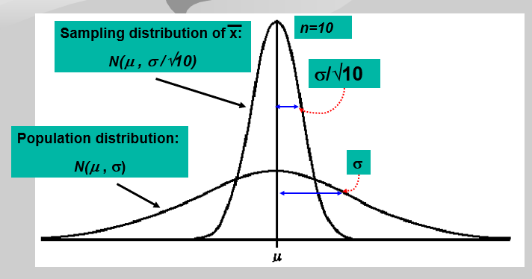
Central Limit theorem
If a random sample of n observations is selected from a population (any population), then when n is sufficiently large, the sampling distribution of x will be approximately normal.
The larger the sample size, the better will be the normal approximation to the sampling distribution of x
By the Central Limit Theorem: the shape of the sampling distribution is approx. normal, that is
x ~ N(μ, σ/√n)

Slide 18
Hypothesis Test
Is a claim and objective of a test to reject or retain
It contains two complementary statements called null and alternative hypothesis . Whereas null is an existing belief and alternative is what we intended to establish with new evidences.
Classified in to parametric and non parametric tests. Parametric test are about population parameter of a distribution such as mean, proportion, std deviation etc and non parametric tests are not about parameters but other characteristics such as independent of events or distributions.
Example
Smokers are better sales people
Women use camera phone more than men
Children who drink health drink are likely to grow taller

Slide 19
Steps of Hypothesis Test
Define null and alternate hypothesis test H_{o} & H_{A}
Identify the test static to be used for testing the validity ; z-test or t-test
Decide the criteria for rejection and retention of null hypothesis; This is Called significance value (α )
Calculate p value (probability value) which is the conditional probability of observing the test static value when the null hypothesis is true.
Take the decision of reject or retain the null hypothesis on the p value and α

Slide 20
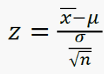
Z-Test & Example
Z-test used when
Test the value of population mean when the population variance is known
The population is normally distributed and population variance is known
The sample size is large and population variance is known
Z static is calculated as

Slide 21
Z-Test & Example
Example: A passport office claims that the passport application are processed within 30 days of submitting the application from and all necessary documents. The file passport.csv contains processing time of 40 passport applicants. The population standard deviation of the processing time is 12.5 days. Conduct a hypothesis test at a significance level α=0.05 to verify the claim made by the passport office.
Hint: We can calculate the z-statistic value is more than -1.64 (Z critical value for left tailed test), then it will be concluded that the processing time is not less than 30, but higher . And if value is less than -1.64 then it will be concluded that processing time is less than 30 as claimed by office.

Slide 22

One sample t-Test
The t-test is used when population std deviation is unknown and estimated from the sample
Condition: central limit theorem
Example- Aravind production(AP) is a newly formed movie production house based out of Mumbai. AP was interested in understanding the production cost required for producing Bollywood movie. The industry believes that the production house will require INR 500 Million on average. It is assumed that the Bollywood movie production cost follows a normal distribution. The production cost of 40 Bollywood movies in a millions of rupees are given in bollywoodmovies.csv file. Conduct an appropriate hypothesis test at α=0.05 to check whether the belief about average production cost is correct.

Slide 23
Two sample t- Test
The two sample t-test is used to test difference between two population means where standard deviation are unknown.
Example- A company claims that children (in the group between 7-12) who drink their health drink will grow taller than the children who don’t drink that health drink. Data in the file healthdrink.xlsx shows average increase in height over one year period from two groups: One drinking the health drink and the other not drinking the health drink. At α=0.05 , test whether the increase in height for the children who drink the health drink is different than those who don’t drink health drink.
- Population mean and std deviation are not known. We have only two samples.

Slide 24
Paired sample t-test
To test whether an intervention or (treatment) such as an event, training program, marketing promotions may have significantly changed the population parameter such as mean before and after intervention.
The objective is to check whether the difference in parameter values is statistically significant before and after the interventions or between different types of interventions.
Example- The file breakfast contains alcohol consumption before and after breakfast. Conduct a paired test t-test to check whether the alcohol consumption is more after the breakfast at 95% CI

Slide 25
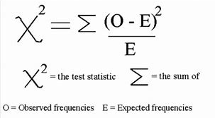
Chi-Square Goodness of Fit test
Chi-Square goodness of fit is an non parametric test used for comparing the observed distribution of data with the expected distribution of data to decide whether there is any statistically significant difference between the observed and theoretical distribution.
Example- Hanuman airlines (HA) operated daily flights to several Indian cities. One of the problem HA faces is the food preference by the passengers. Captain Cook, the operation manager of HA , believes that 35% of their passenger prefer vegetarian food, 40% prefer non vegetarian food, 20% low calorie food and 5% for diabetic food. A sample of 500 passengers was chosen to analyze the food preferences and the observed frequencies are as follows
Vegetarian-190
Non- Vegetarian- 185
Low calorie-90
Diabetic- 35

Slide 26
Chi-Square Goodness of Fit test
Chi-Square goodness of fit is an non parametric test used for comparing the observed distribution of data with the expected distribution of data to decide whether there is any statistically significant difference between the observed and theoretical distribution.
Example- Hanuman airlines (HA) operated daily flights to several Indian cities. One of the problem HA faces is the food preference by the passengers. Captain Cook, the operation manager of HA , believes that 35% of their passenger prefer vegetarian food, 40% prefer non vegetarian food, 20% low calorie food and 5% for diabetic food. A sample of 500 passengers was chosen to analyze the food preferences and the observed frequencies are as follows
Vegetarian-190
Non- Vegetarian- 185
Low calorie-90
Diabetic- 35

Slide 27
Analysis of Variance
Sometimes it may be necessary to conduct hypothesis to compare mean values simultaneously for more than 2 groups (samples) created using factors.
For example, a marketer like to understand the impact of 3 different discount values on the average values.
One way ANOVA:
Study the impact of a single treatmement (or factor) at different levels (forming different group) on a continuous response variable(outcome variable).
Then the null & alternate hypothesis for one way ANIOVA for comparing 3 groups are given by
H₀ = µ₁= µ₂= µ₃
H_{A:} not all µ values are equal (*some of groups could be equal)

Slide 28
One way ANOVA-Example
Mr. Rachel Khanna the brand manager of ENZO detergent powder at the “one stop” retail was interested in understanding whether the price discount have any impact, price discount of 0% (no discount), 10% and 20% were given on randomly selected days. The quantity (In Kgs) of ENZO sold in a day under different discount levels. Conduct a one way ANOVA to check whether discount had any significant impact on the average sales quantity at 95% CI
Dataset name- one stop.csv
Hint: ANOVA can be conducted to test if there is any effect of discount on the average sales.

